Slide 1




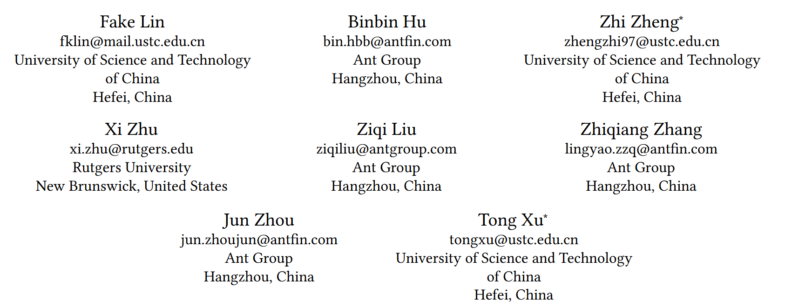





ATAI
Advanced Technique of Artificial Intelligence
ATAI
ChongqingUniversity _{AdvancedTechniqueof}
of Technology Artificial Intelligence
Chongqing University of
Technology
Chongqing University ^{ATAI}
_{of Technology} Advanced Techniqueof
Artificial Intelligence
Chongqing University of Technology
Chongqing University of Technology
Token-level Collaborative Alignment for LLM-based Generative Recommendation
Code : https://github.com/critical88/TCA4Rec.
——WWW_2026
Reported by Yuhang Jang
1

Slide 2
ATAI
Advanced Technique of Artificial Intelligence
ATAI
ChongqingUniversity _{AdvancedTechniqueof}
of Technology Artificial Intelligence
Chongqing University of
Technology
Chongqing University ^{ATAI}
_{of Technology} Advanced Techniqueof
Artificial Intelligence
Chongqing University of Technology
Chongqing University of Technology
Motivation
1) Existing LLM-based recommender systems struggle to effectively incorporate collaborative filtering (CF) signals, due to a fundamental mismatch between item-level preference modeling in CF and token-level next-token prediction (NTP) optimization in LLMs.

Slide 3
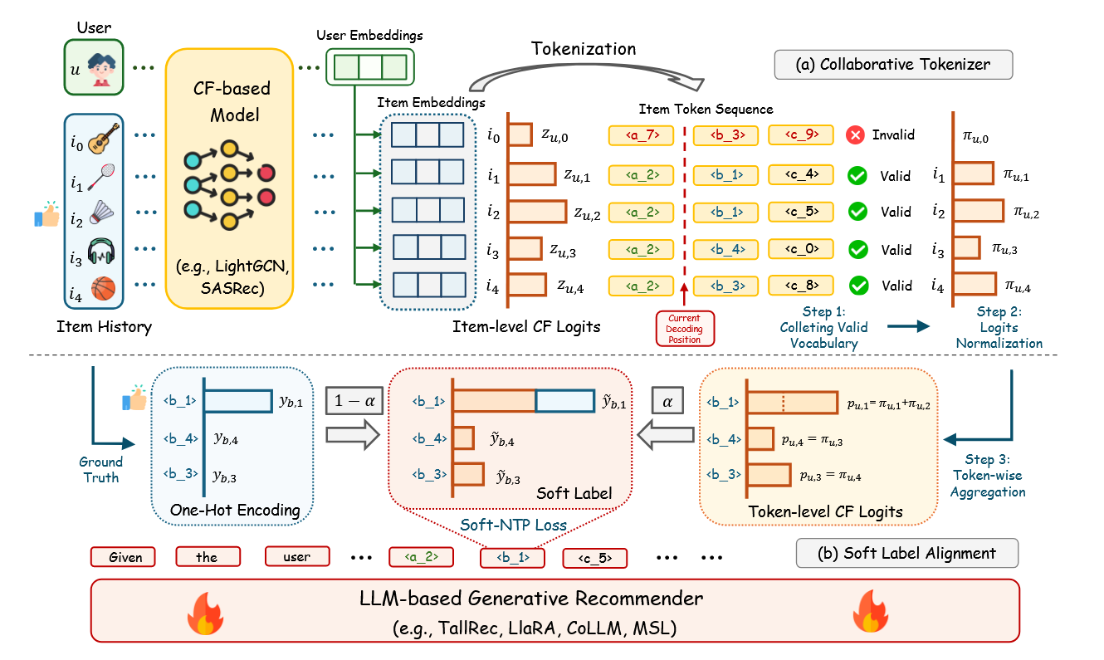
ATAI
Advanced Technique of Artificial Intelligence
ATAI
ChongqingUniversity _{AdvancedTechniqueof}
of Technology Artificial Intelligence
Chongqing University of
Technology
Chongqing University ^{ATAI}
_{of Technology} Advanced Techniqueof
Artificial Intelligence
Method
Chongqing University of Technology
Chongqing University of Technology

Slide 4

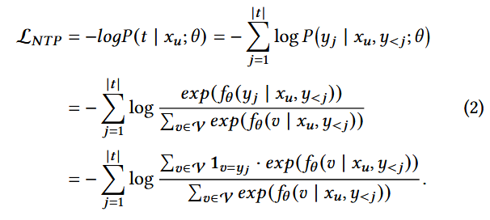

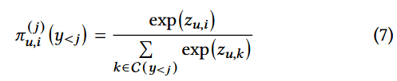



ATAI
Advanced Technique of Artificial Intelligence
ATAI
ChongqingUniversity _{AdvancedTechniqueof}
of Technology Artificial Intelligence
Chongqing University of
Technology
Chongqing University ^{ATAI}
_{of Technology} Advanced Techniqueof
Artificial Intelligence
Chongqing University of Technology
Chongqing University of Technology
Method

Slide 5
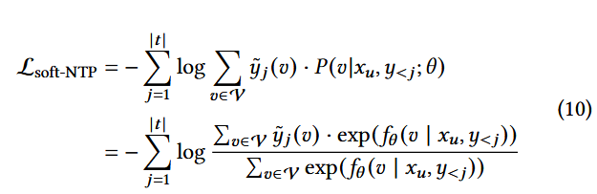


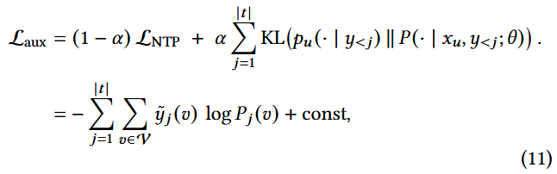
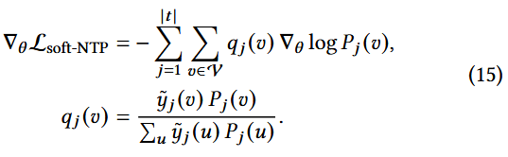


ATAI
Advanced Technique of Artificial Intelligence
ATAI
ChongqingUniversity _{AdvancedTechniqueof}
of Technology Artificial Intelligence
Chongqing University of
Technology
Chongqing University ^{ATAI}
_{of Technology} Advanced Techniqueof
Artificial Intelligence
Chongqing University of Technology
Chongqing University of Technology
Method
Notes:
用子注意力进行融合q为当前模态，k与v为其他模态信息

Slide 6

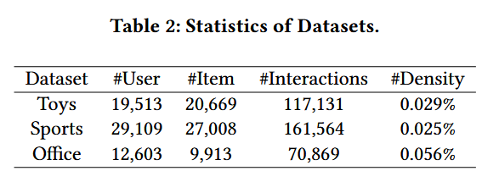
ATAI
Advanced Technique of Artificial Intelligence
ATAI
ChongqingUniversity _{AdvancedTechniqueof}
of Technology Artificial Intelligence
Chongqing University of
Technology
Chongqing University ^{ATAI}
_{of Technology} Advanced Techniqueof
Artificial Intelligence
Chongqing University of Technology
Chongqing University of Technology

Slide 7
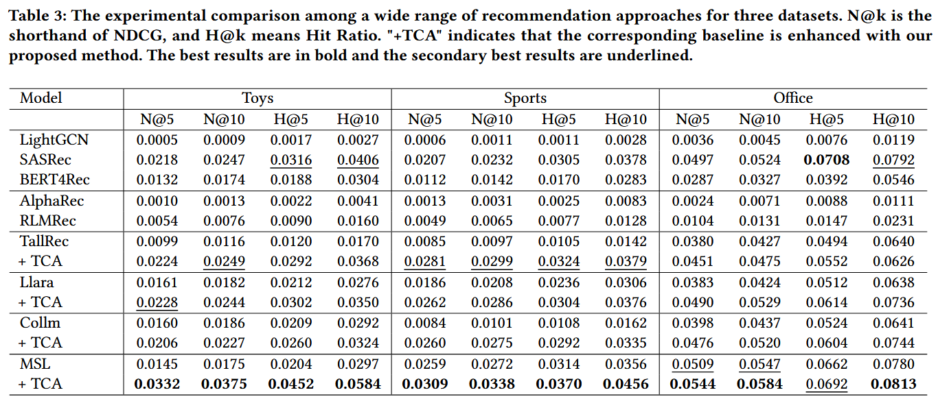
ATAI
Advanced Technique of Artificial Intelligence
ATAI
ChongqingUniversity _{AdvancedTechniqueof}
of Technology Artificial Intelligence
Chongqing University of
Technology
Chongqing University ^{ATAI}
_{of Technology} Advanced Techniqueof
Artificial Intelligence
Chongqing University of Technology
Chongqing University of Technology

Slide 8
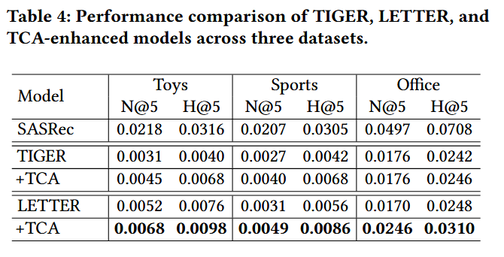
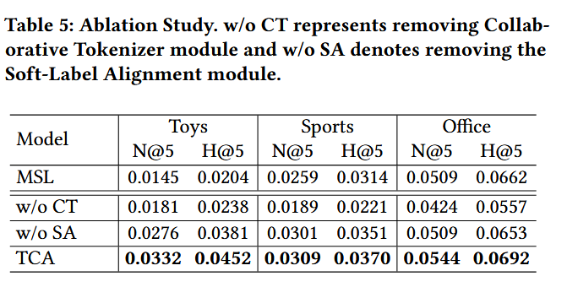
ATAI
Advanced Technique of Artificial Intelligence
ATAI
ChongqingUniversity _{AdvancedTechniqueof}
of Technology Artificial Intelligence
Chongqing University of
Technology
Chongqing University ^{ATAI}
_{of Technology} Advanced Techniqueof
Artificial Intelligence
Chongqing University of Technology
Chongqing University of Technology
Notes:
第一个是再codebook的时候进行跨模态对齐的，第二个是最后进行对齐损失，第三个是用文本模态生成视觉模块的，第四个是进行训练transformer encode。 右边的实验说的是，我拿出第二层，然后将256个每个codebook向量的被选中的数目从大到小排列，然后16个聚合，发现之前的方法会出现长尾效应，但是现在这个方法缓解了长尾效应。

Slide 9
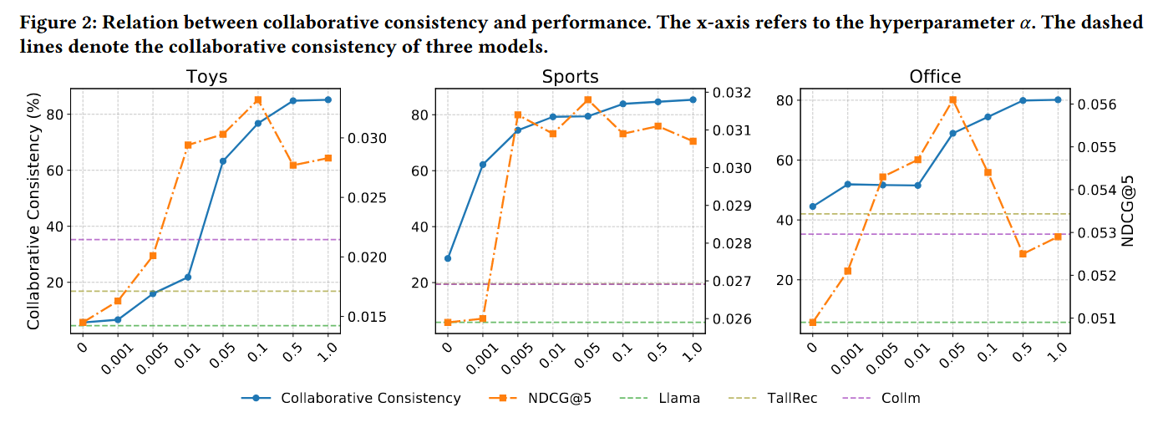
ATAI
Advanced Technique of Artificial Intelligence
ATAI
ChongqingUniversity _{AdvancedTechniqueof}
of Technology Artificial Intelligence
Chongqing University of
Technology
Chongqing University ^{ATAI}
_{of Technology} Advanced Techniqueof
Artificial Intelligence
Chongqing University of Technology
Chongqing University of Technology
Notes:
第三个实验，可以发现当越晚后面会出现信息比较少，使用其他的模态信息补齐可以缓解

Slide 10
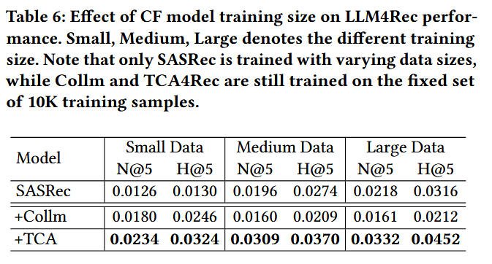
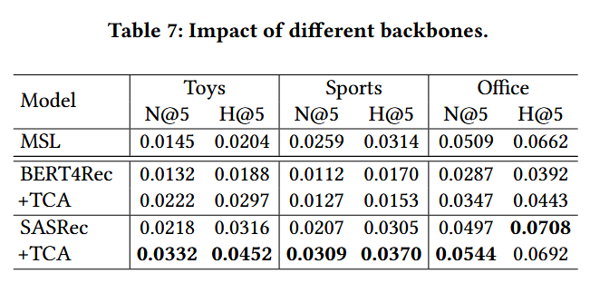
ATAI
Advanced Technique of Artificial Intelligence
ATAI
ChongqingUniversity _{AdvancedTechniqueof}
of Technology Artificial Intelligence
Chongqing University of
Technology
Chongqing University ^{ATAI}
_{of Technology} Advanced Techniqueof
Artificial Intelligence
Chongqing University of Technology
Chongqing University of Technology

Slide 11


ATAI
Advanced Technique of Artificial Intelligence
ATAI
ChongqingUniversity _{AdvancedTechniqueof}
of Technology Artificial Intelligence
Chongqing University of
Technology
Chongqing University ^{ATAI}
_{of Technology} Advanced Techniqueof
Artificial Intelligence
Chongqing University of Technology
Chongqing University of Technology
Thanks!

